Slide 1




LEVELS
Home
Service
About Us
Contact
PRESENTING
Stellar Stays
where luxury meets comfort
STELLARSTAYS@GMAIL.COM

Slide 2
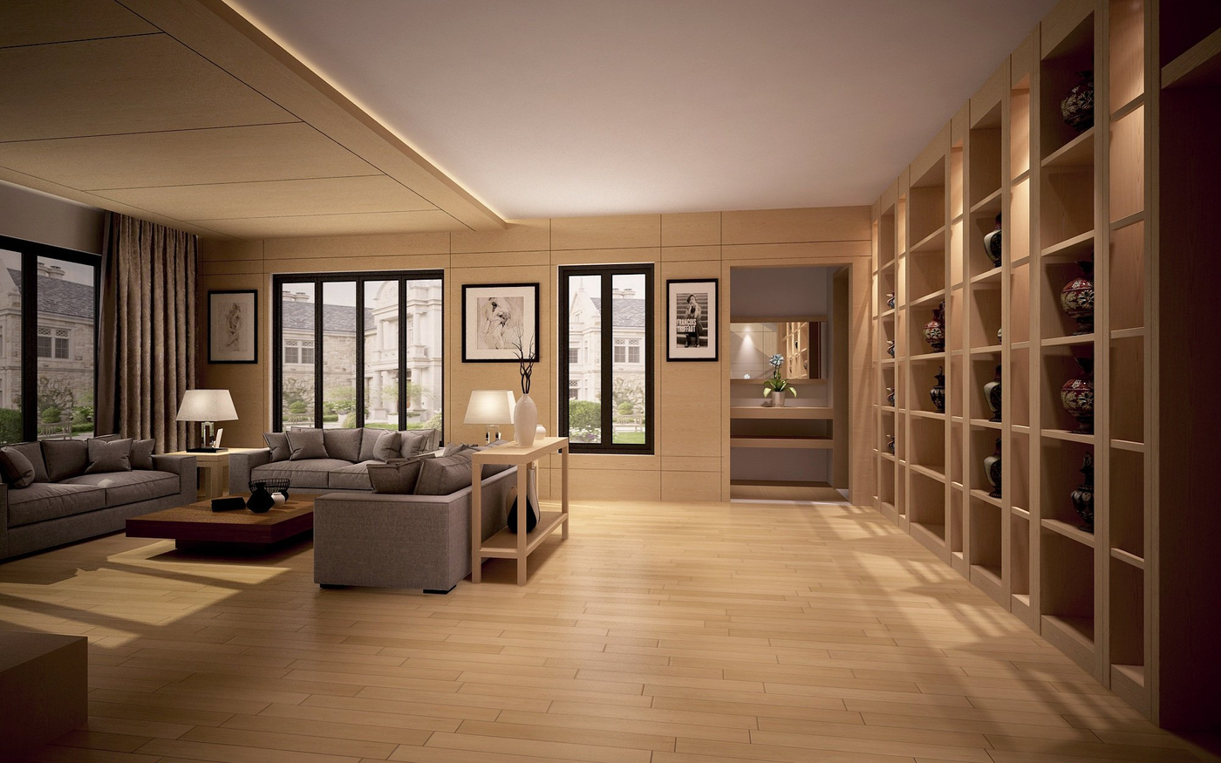
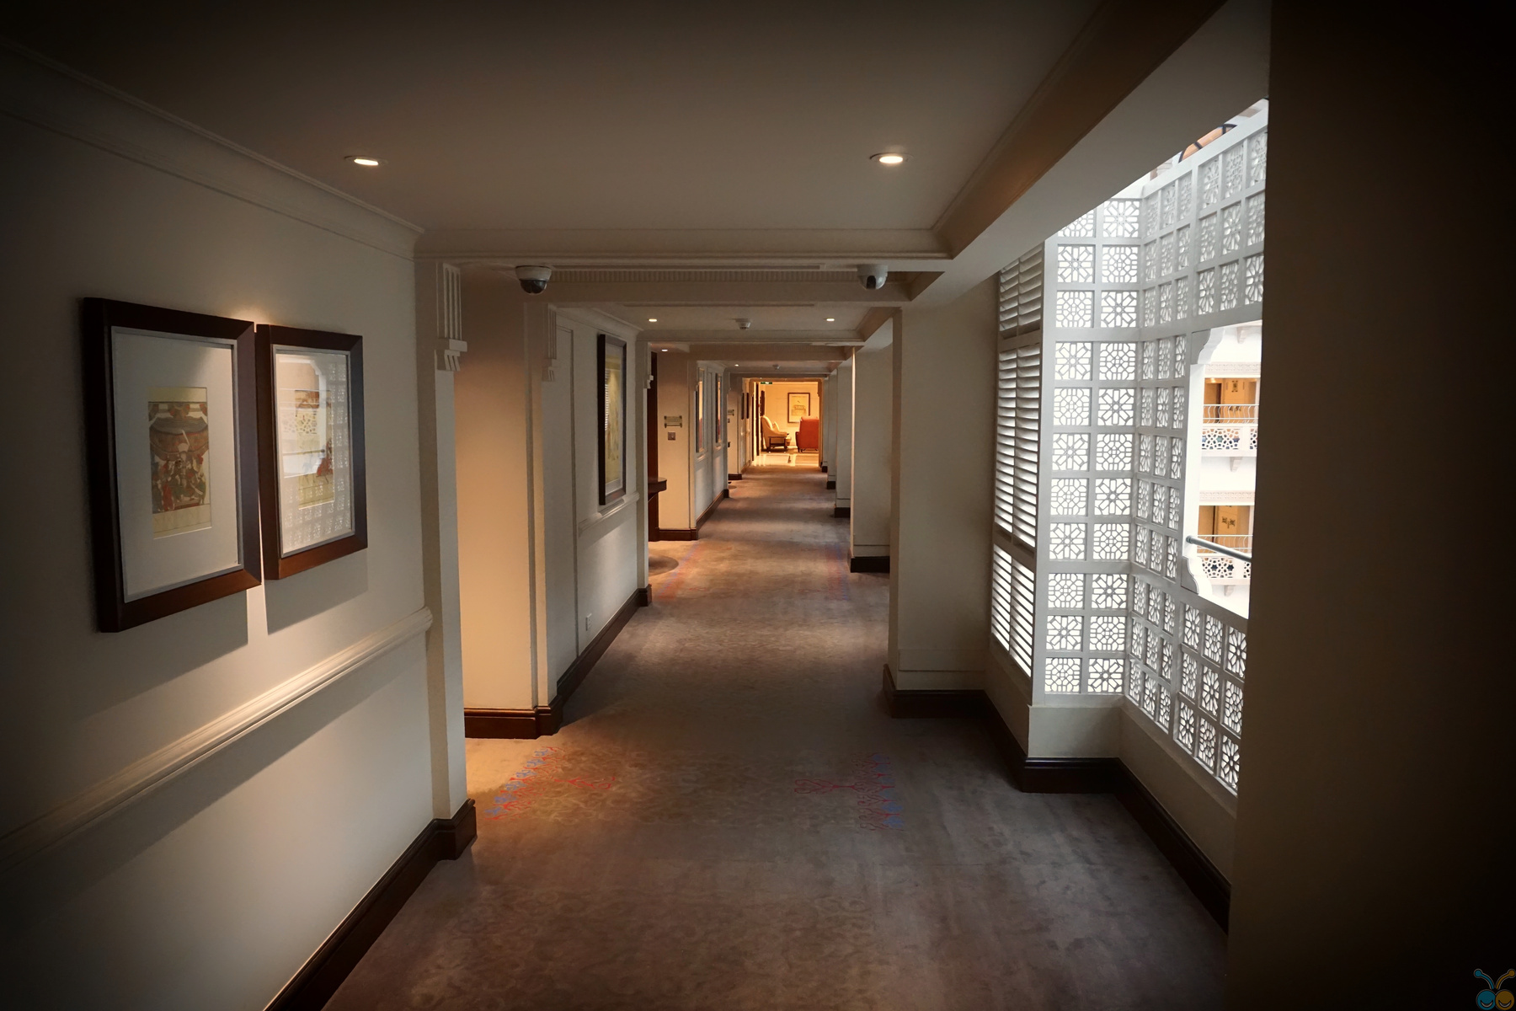
Welcome to Our Hotel
MAIN IDEA
For Customers: Offers an intuitive platform for booking, viewing menus, placing orders, and giving feedback, ensuring a seamless dining experience.
For Staff: Simplifies services and order management, billing, inventory tracking, and reporting, allowing staff to focus on excellent service and reduce operational errors.

Slide 3
USE CASES
01
BOOKING
06
CHECKOUT
11
VIEW FEEDBACK
02
07
GIVE FEEDBACK
12
HANDLE GYM SERVICES
CANCEL BOOKING
03
08
13
REPORT STOCK
CHECKIN
MAKE PAYMNET
04
ORDER FOOD
09
14
MANAGE ROOMS
UPDATE INVENTORY
05
REQUEST SERVICES
10
HANDLE RESTAURANT SERVICES
15
GENERATE BILL

Slide 4
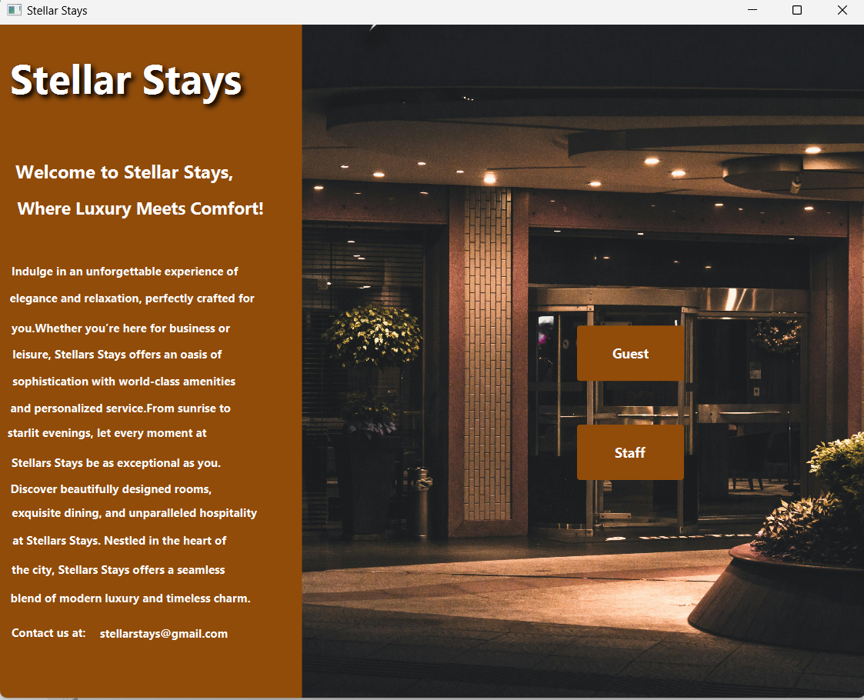
About Our Hotel
First Screen: Features Staff and Guest buttons.
Staff Button: Opens the Staff Interface for managing hotel operations.
Guest Button: Opens the Guest Interface for booking rooms, feedback, and hotel services.

Slide 5
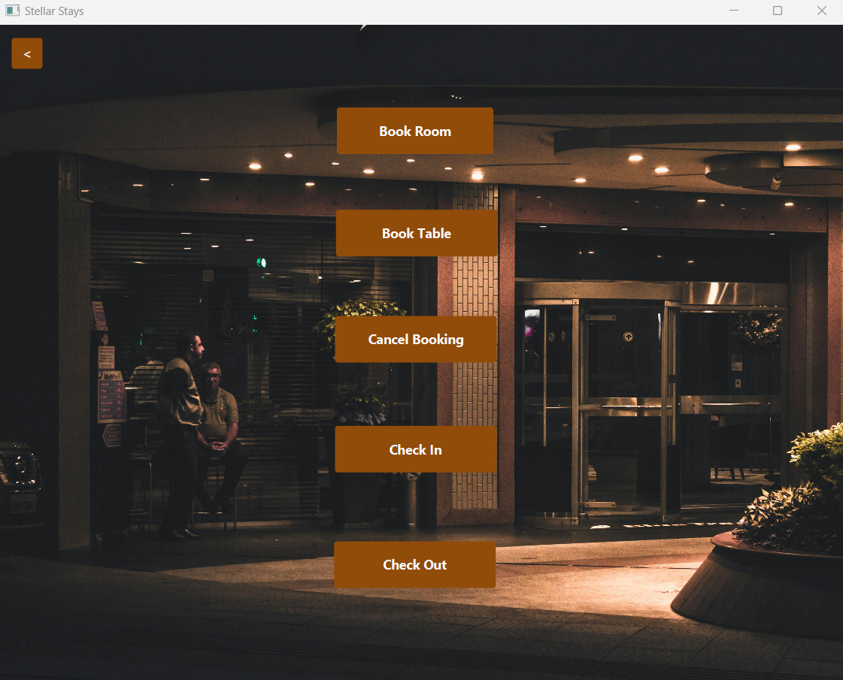
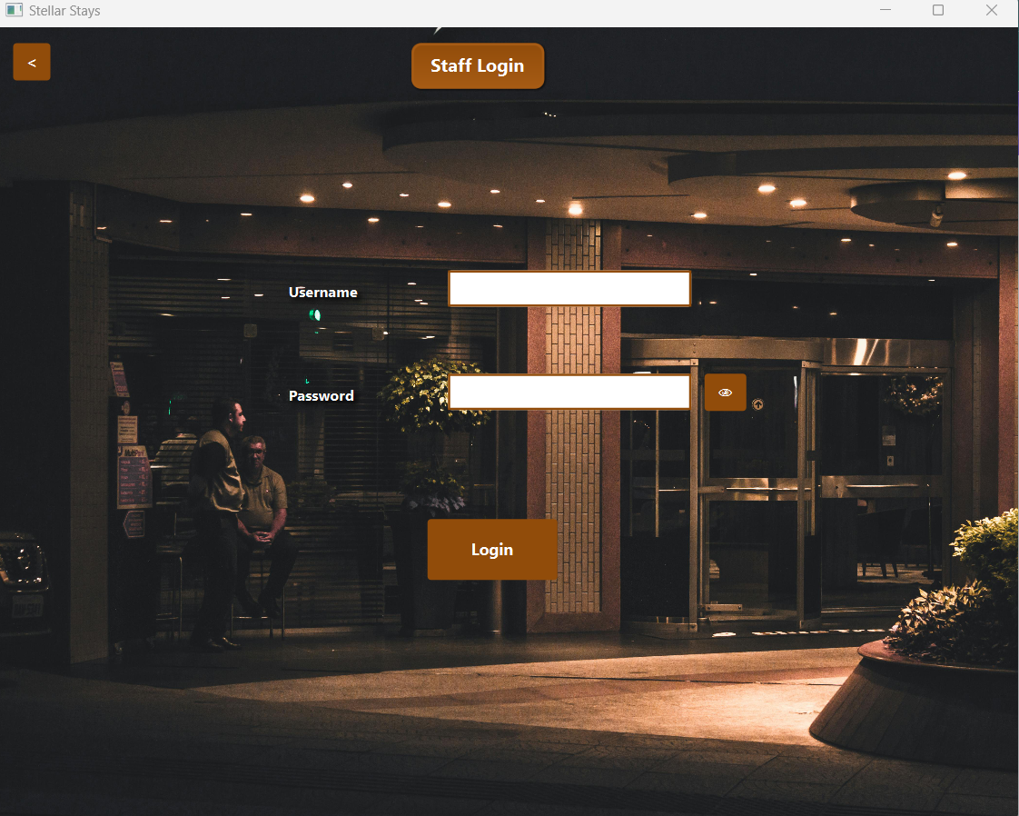
MAIN ACTORS
GUEST
2. STAFF
MAIN MANAGER
CREW
RESTAURANT STAFF
GYM MANAGER

Slide 6
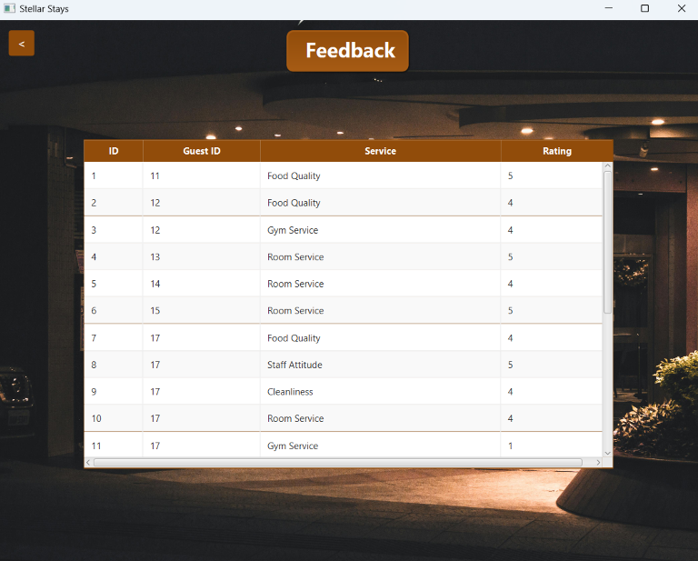
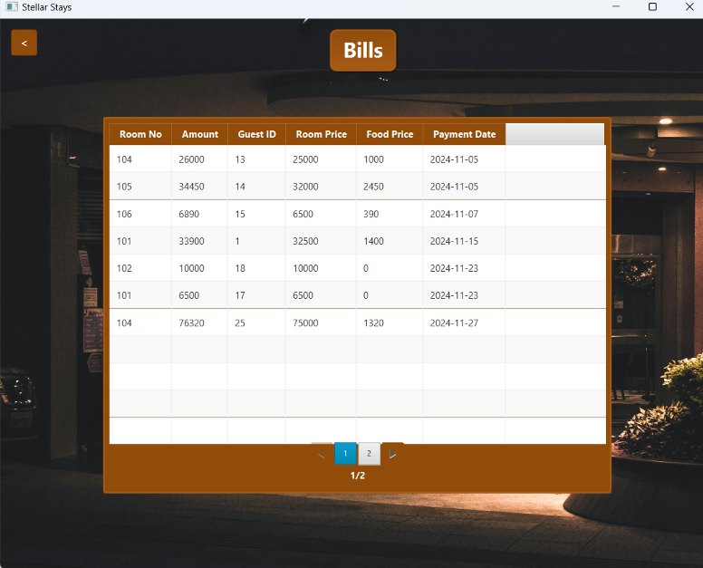
VIEW FEEDBACK - BILL

Slide 7
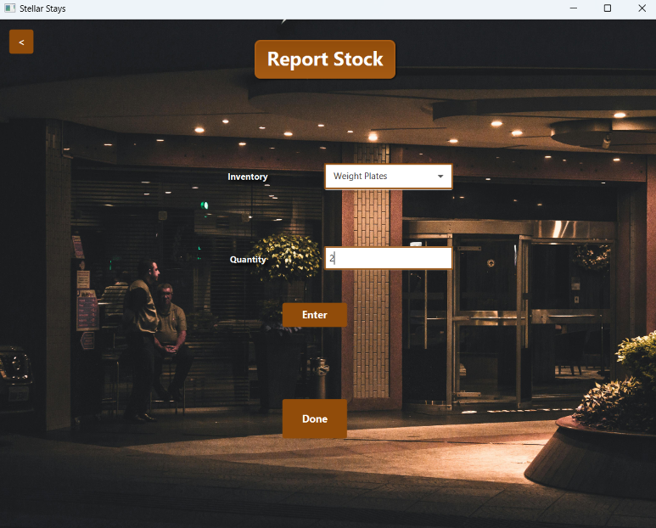
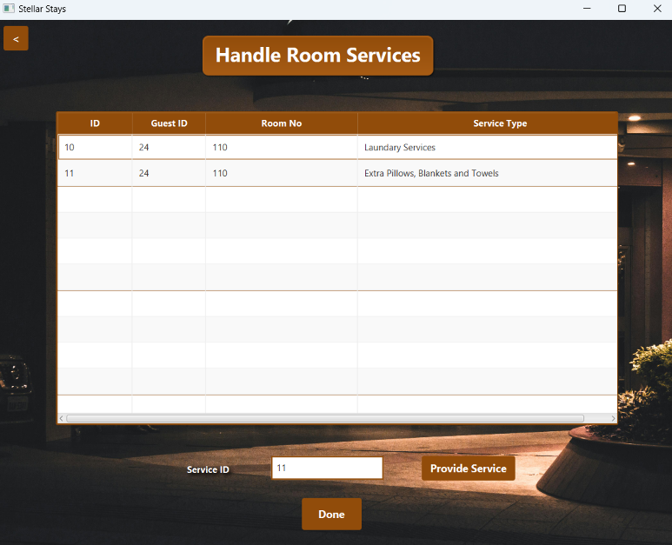
REPORT/UPDATE STOCK
HANDLE SERVICES

Slide 8
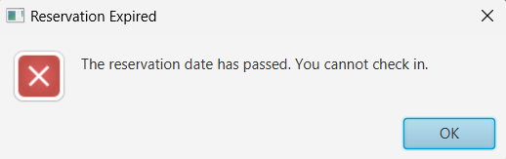
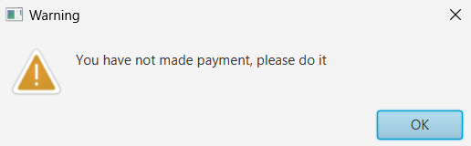
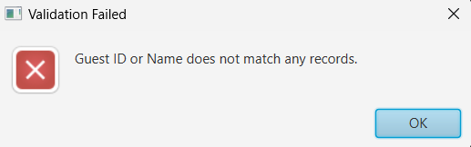
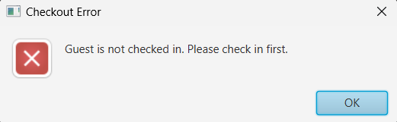
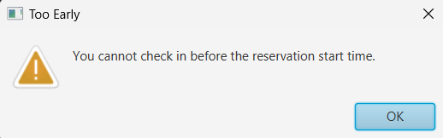
CHECKIN / CHECKOUT

Slide 9
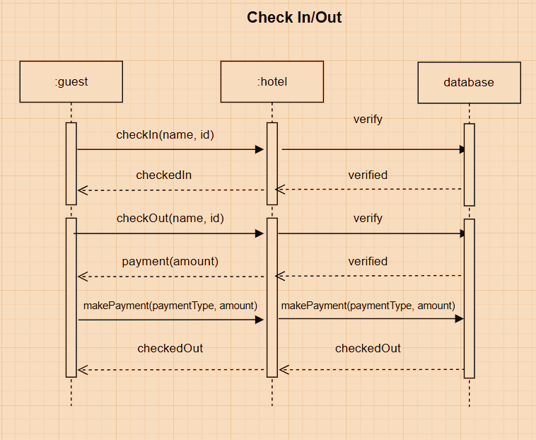
SEQUENCE DIAGRAM

Slide 10
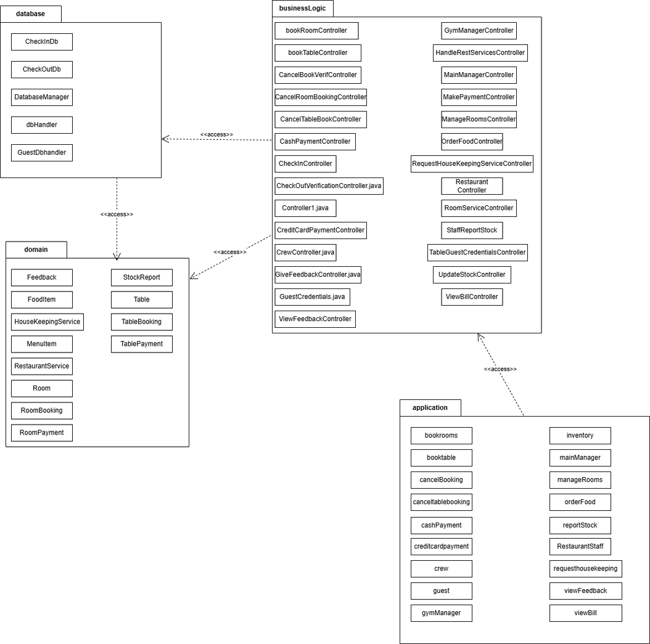
PACKAGE DIAGRAM

Slide 11
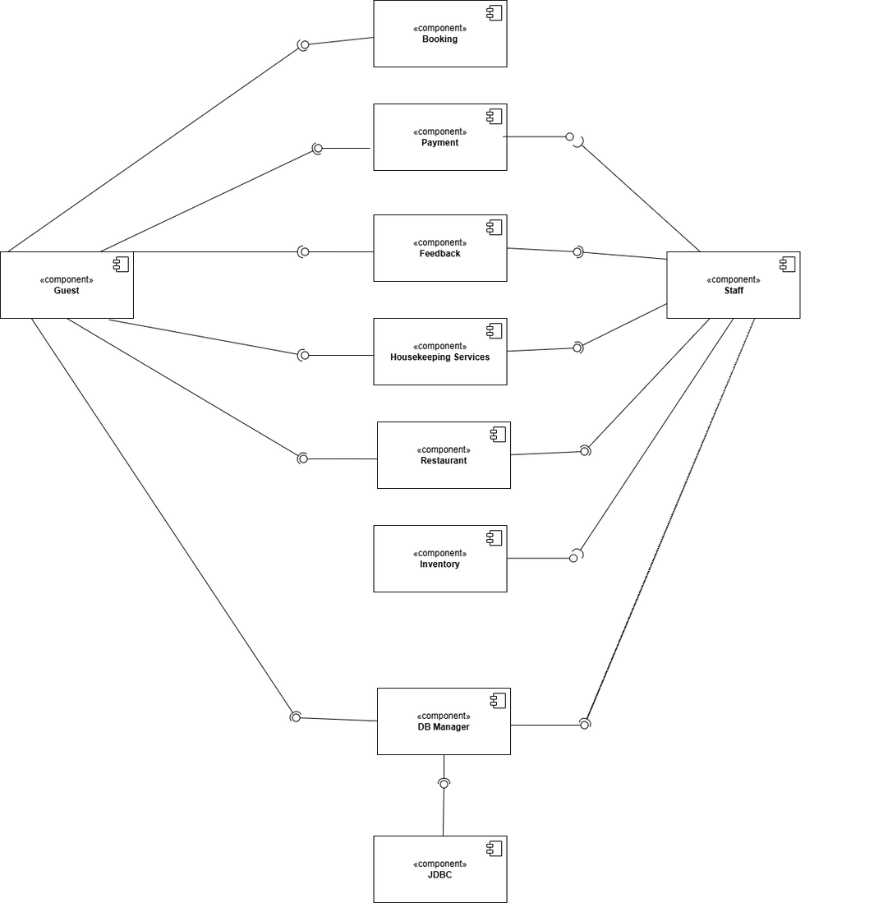
COMPONENT DIAGRAM

Slide 12

STELLAR STAYS
Thank You
PRESENTATION BY : FIZA WAJID
ATHAAR FATIMA
AMBREEN ARSHAD

